Slide 1
Multimedia Streaming Services: Data Structures and Algorithms in Action
Optimizing Content Delivery and Personalization

Slide 2
TEAM MEMBERS:
1.KANISHQ GOUD (RA2311003010717) : Idea Generation:All three members collaborate in brainstorming sessions to develop and refine project ideas.
2.N DHANUSH (RA2311003010731):PowerPoint Creation:One member focuses on designing the PowerPoint presentation, ensuring it effectively communicates the project's concepts and plans.
3.T AKSHAYA (RA2311003010732): Implementation: other two implemented the ppt

Slide 3
Abstract:-
Overview:
Multimedia streaming services have transformed how we consume content, offering on-demand access across diverse media. These platforms leverage advanced data structures and algorithms to ensure seamless user experiences, efficient data handling, and tailored recommendations.

Slide 4
Introduction:-
Context:
  Streaming services like Netflix, YouTube, and Spotify handle vast amounts of multimedia content.
  They aim to provide uninterrupted streaming, personalized recommendations, and adaptive quality based on user bandwidth.
Key Aspects:
  Content Delivery: Efficient caching and streaming.
  Personalization: Recommendations based on user behavior.
  Bandwidth Adaptation: Dynamic video quality adjustment.

Slide 5
Problem Statement:-
Challenges in Multimedia Streaming:
  Efficient Content Delivery: Minimize buffering and latency.
  Content Caching: Reduce server load with effective caching.
  Personalized Recommendations: Increase user engagement through accurate suggestions.
  Bandwidth Adaptation: Provide a consistent experience across varying network speeds.

Slide 6
Algorithms and Data Structures Used:-
Content Delivery & Caching:
  LRU Cache: Stores frequently accessed content, evicting the least recently used items.
  CDN (Content Delivery Network): Distributes content to servers near users, reducing load times.
Recommendation Engine:
  Collaborative Filtering: Identifies user preferences by analyzing interaction patterns.
  Matrix Factorization: Reduces large datasets for efficient similarity calculation.
  Deep Learning Models: Neural networks capture complex user-item relationships.
Adaptive Bitrate Streaming:
  DASH (Dynamic Adaptive Streaming over HTTP): Adjusts quality based on network speed.

Slide 7
Algorithm Demonstration: LRU Cache (Content Caching):-
Description:
  LRU (Least Recently Used) caches the most frequently accessed content.
  Evicts least accessed items when storage reaches capacity.
Applications:
  Reduces server requests, improving response time for frequently accessed content

Slide 8
LRU Cache Algorithm - Content Caching:-
Code:
#include <stdio.h>
#include <stdlib.h>
typedef struct Node {
int key;
int value;
struct Node* next;
struct Node* prev;
} Node;
typedef struct {
Node* head;
Node* tail;
int capacity;
int size;
} LRUCache;
Node* createNode(int key, int value) {
Node* node = (Node*)malloc(sizeof(Node));
node->key = key;
node->value = value;
node->next = node->prev = NULL;
return node;
}

Slide 9
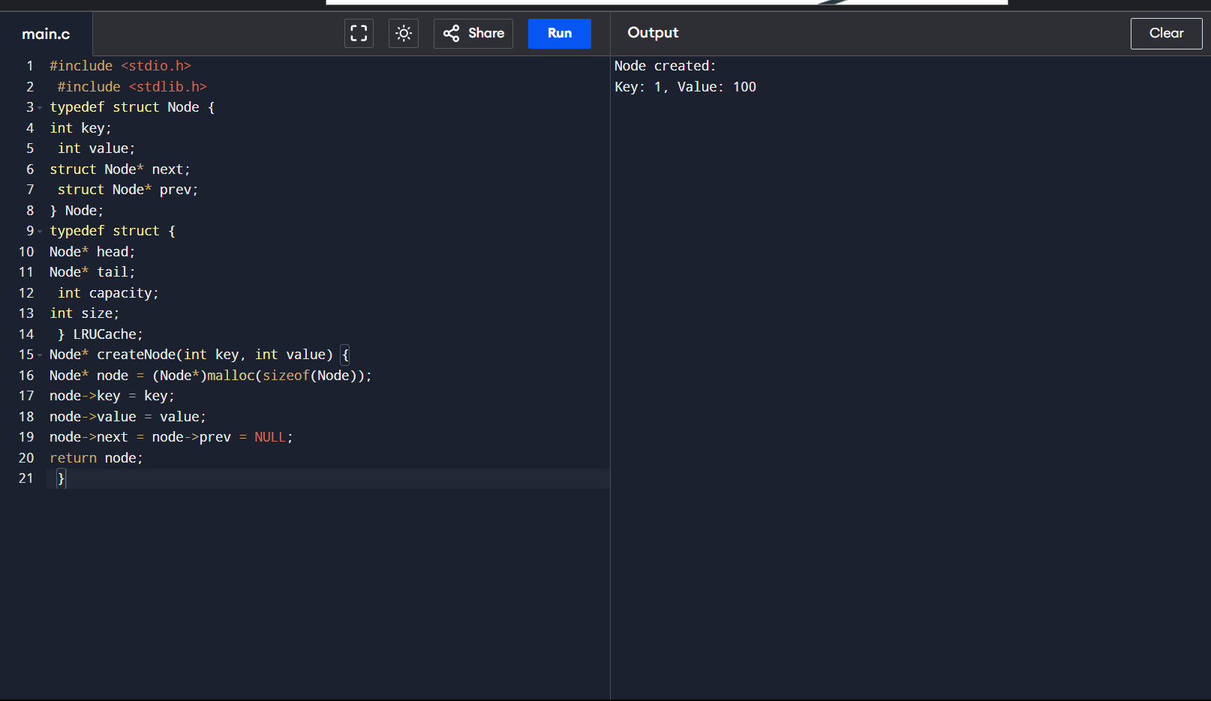

Slide 10
LRU Cache - Operations (Part 2):-
Additional Functions:
void moveToHead(LRUCache* cache, Node* node) {
if (cache->head == node) return;
if (node == cache->tail) cache->tail = node->prev;
if (node->prev) node->prev->next = node->next;
if (node->next) node->next->prev = node->prev;
node->next = cache->head;
node->prev = NULL;
cache->head->prev = node;
cache->head = node;
}
void addNodeToHead(LRUCache* cache, Node* node) {
node->next = cache->head;
if (cache->head) cache->head->prev = node;
cache->head = node;
if (!cache->tail) cache->tail = node;
}

Slide 11
Collaborative Filtering - Recommendations (Part 1):-
Code:
#include <stdio.h>
#define MAX_USERS 100
#define MAX_ITEMS 100
float ratings[MAX_USERS][MAX_ITEMS] = {0}; // Rating matrix for users and items
void addRating(int user, int item, float rating) {
ratings[user][item] = rating;
}

Slide 12
Collaborative Filtering - Recommendation Function (Part 2):-
void recommendItems(int user, int num_items) {
float scores[MAX_ITEMS] = {0};
int count[MAX_ITEMS] = {0};
for (int other_user = 0; other_user < MAX_USERS; ++other_user) {
if (other_user == user) continue;
for (int item = 0; item < MAX_ITEMS; ++item) {
if (ratings[other_user][item] > 0) {
scores[item] += ratings[other_user][item];
count[item]++;
}
}
}
printf("Recommended items for user %d:\n", user);
for (int item = 0; item < num_items; ++item) {
if (count[item] > 0) {
float avg_score = scores[item] / count[item];
printf("Item %d with average score %.2f\n", item, avg_score);
}
}
}

Slide 13
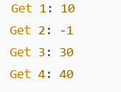
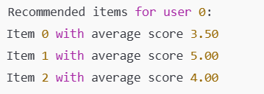
Output of LRU Cache Code:-
Output of Collaborative Filtering Code:-

Slide 14
Conclusion:-
Multimedia streaming services rely on data structures andalgorithms to enhance user experience.
LRU Cache optimizes content delivery, Collaborative Filtering recommends relevant items, and adaptive streaming ensures smooth playback.
  Effective implementation of these techniques allows streaming platforms to reduce server loads, enhance engagement, and improve viewing experiences across varied network conditions

Slide 15


